Slide 1

Integration of genomics into surveillance and risk assessment for outbreak investigation: case studies from South Africa
10 September 2025
With thanks to colleagues from CRDM and SCF at the NICD

Slide 2
Surveillance programs at CRDM
Sentinel syndromic surveillance (surveillance for ILI and Pneumonia)
Influenza, RSV, SARS-CoV-2, B. pertussis
National laboratory-based surveillance (GERMS)
Pneumococcus, H. influenzae, meningococcus, Group A and B streptococcus
Aims: Detect outbreaks and identify causal pathogen, identify risk groups, evaluate interventions, guide vaccine strain selection and vaccine policy

Slide 3
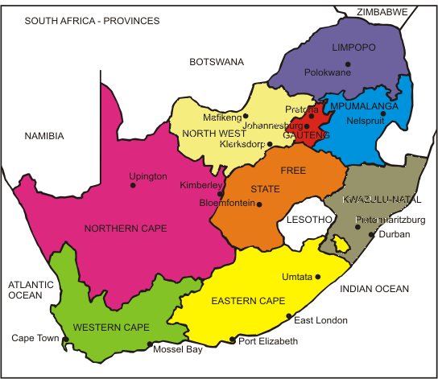
ILI and Pneumonia surveillance sites, South Africa
Rahima Moosa Mother and Child Hospital (2014)
Mapulaneng and Matikwana
Hospitals (2009)
Tintswalo Hospital (2020)
Klerksdorp-Tshepong Hospital Complex (2010)
Agincourt Clinic (2016)
Jouberton Clinic (2012)
Red Cross Memorial Childrens’ Hospital and Mitchell’s Plain Hospital (2016)
Edendale Hospital (2009)
Edendale Gateway Clinic (2012)
Eastridge Clinic (2019) and Mitchell’s Plain Clinic (2019)
ILI: influenza-like illness
SRI: severe respiratory illness
6000 specimens collected annually
Etiology of severe respiratory illness and influenza-like illness
Nasopharyngeal specimens in universal transport medium
B. pertussis, RSV, influenza and SARS-CoV-2

Slide 4
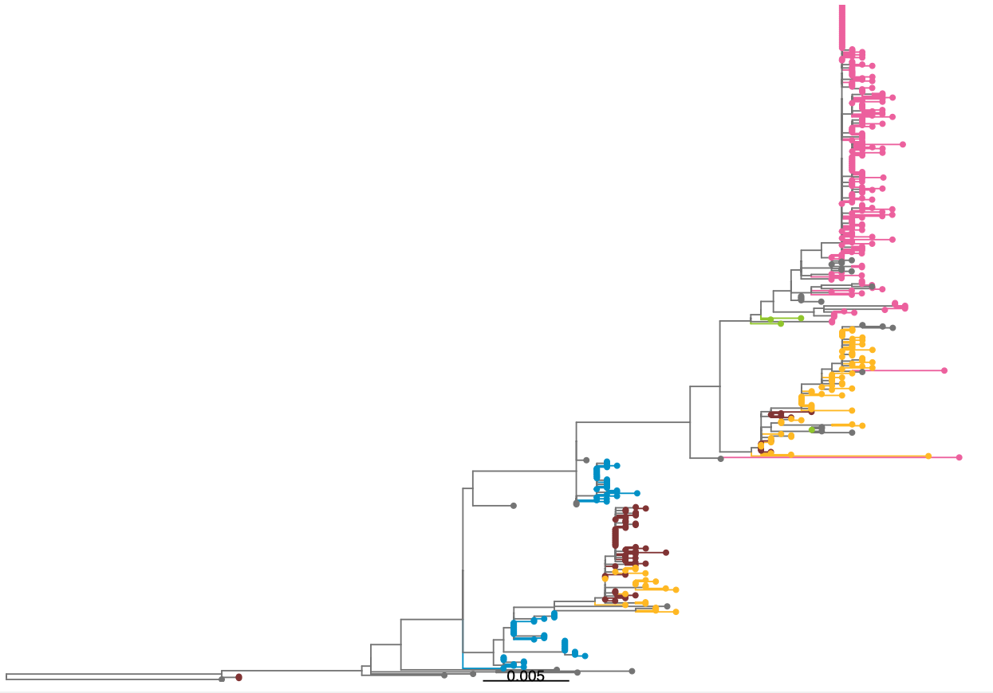
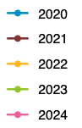
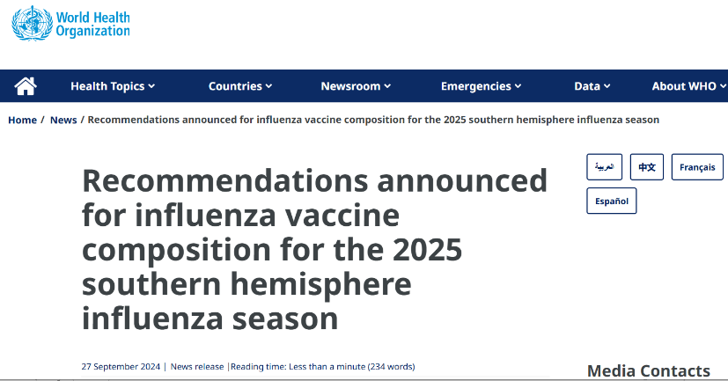
Phylogenetic tree based on hemagglutinin (HA) of influenza A(H1N1)pdm09 in South African, 2020- 07 November 2024
Influenza virus – monitor viral evolution and update vaccines as needed
6B.1A.5a.2a
2024 viruses (n=370) clustered within the 5a.2a clade (37/98, 97%) and the 5a.2a.1 clade (with vaccine strain) (1/98, 3%)
T120A,
K169Q
Year
6B.1A.5a.2a.1
6B.1A.5a.2
2024 Vaccine strain
6B.1A.5a.1
Global reference sequences
6B.1A.5a

Slide 5
Number and cumulative number of laboratory-confirmed cases of COVID-19, by date of specimen collection, South Africa, 3 March 2020 – 19 November 2022 (n= 4 038 051)
Beta
Delta
Omicron BA.1/2
Wildtype/Wuhan
Omicron BA.4/5

Slide 6
GERMS
National, laboratory-based surveillance
H. influenzae, N. meningitidis, S. pneumoniae, S. agalactiae (GBS), S. pyogenes (GAS)
Normally-sterile site specimens (e.g. CSF and blood) and isolates
Organism identification and serotyping/grouping using phenotypic and genotypic methods
Antimicrobial susceptibility testing
Genomic surveillance
Tracking of lineages (including drug-resistant lineages and resistance determinants)
Expansion or emergence of non-vaccine serotypes that are drug resistant

Slide 7
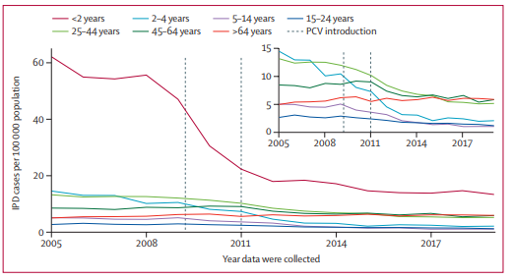
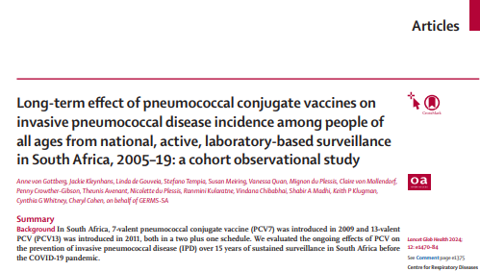
Incidence of invasive pneumococcal disease (IPD) reported by year and age group, and the insert graph excluding children younger than 2 years, in South Africa in 2005–19
Decline in IPD following PCV7 (2009) and PCV13 (2011) implementation, especially among children younger than 2 years
Decline among other age groups due to herd effect
Increase in some non-PCV serotypes lead by serotype 8

Slide 8
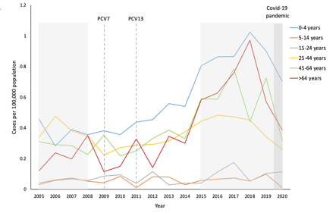
Incidence of serotype 8 invasive pneumococcal disease reported by year, and by age group, in South Africa, 2005 through 2020
Increase in some non-PCV serotypes lead by serotype 8

Slide 9
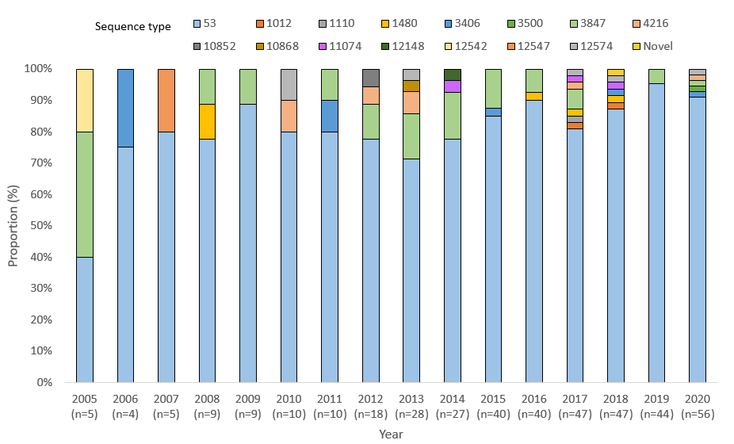
Pneumococcal serotype 8 sequence type distribution by year, among persons of all age groups in South Africa, 2005 – 2014 (N=399)
Increase in serotype 8 is due to pre-existing lineage (ST53)
Lekhuleni et al., 12th International Symposium on Pneumococci and Pneumococcal Diseases (ISPPD-12), Sheraton Centre Toronto Hotel, Toronto, Canada, June 19-23, 2022, poster presentation: Genomic epidemiology of invasive pneumococcal serotype 8 in the pre- and post-PCV13 eras in South Africa, 2005-2014
Notes:
WGS: Increase in serotype 8 is due to pre-existing lineage (ST53)

Slide 10
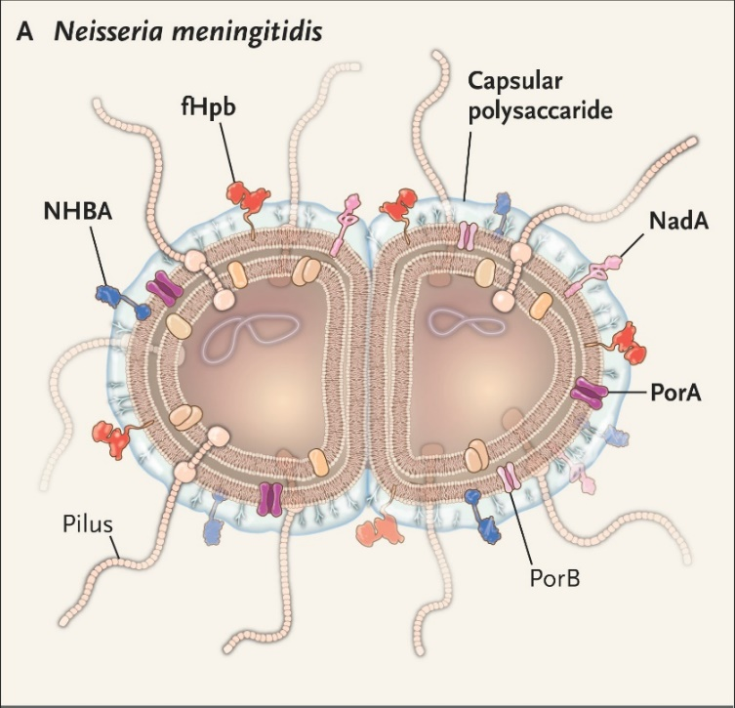
N. meningitidis
Causes invasive meningococcal disease (IMD)
Global case fatality rate of 4% to 20%
Regional outbreaks and epidemics
IMD is a notifiable medical condition (category 1) in SA
4 common capsular grouping (A, B, C, Y, W) are common in SA
Adapted from: Kim, J. H. (2016) ‘A Challenge in Vaccine Development — Neisseria meningitidis Serogroup B’, New England Journal of Medicine, 375(3), pp. 275–278. doi: 10.1056/NEJMe1606015

Slide 11
Core-genome maximum likelihood phylogenetic tree representative of the population structure of invasive meningococcal isolates, South Africa, 2016–2021 (N = 241)
Predominant lineages include:
- NmB (CC41/44, CC32, CC213),
common globally
- NmW (CC11)
Caused epidemics across the
globe
- NmC (CC103), NmY (CC167, CC23)
North America and Europe
Penicillin intermediate resistance detected in 16% of isolates
R. L. Mikhari et al., “ Genomic Diversity and Antimicrobial Susceptibility of Invasive Neisseria meningitidis in South Africa, 2016–2021 ,” J. Infect. Dis., vol. 230, no. 6, pp. 1311–1321, 2024, doi: 10.1093/infdis/jiae225
Notes:
NmW, and less frequently, NmB.
CC11 NmW has caused epidemics across the globe, having emerged from an outbreak in
Saudi Arabia in 2000 [44]

Slide 12
Diphtheria

Slide 13
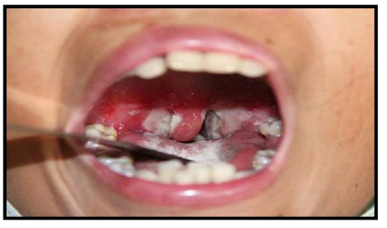
Diphtheria Disease
Category 1 Notifiable Medical Condition (NMC)
Caused by toxin-producing Corynebacterium diphtheriae (or rarely C.ulcerans and C. pseudotuberculosis)
Respiratory diphtheria
Most common manifestation
Soar throat, fever, swollen neck and grey/white pseudomembrane in the upper airway
Cutaneous diphtheria
Skin infection
Laboratory confirmation
All isolates and/or clinical specimens should be sent to the NICD to confirm identification and toxin production

Slide 14
Number of laboratory confirmed toxigenic Corynebacterium diphtheriae 2015-2025, South Africa
2015-2023
26 Respiratory cases
14 Asymptomatic carriers
2 Cutaneous cases
2024-2025
65 Respiratory cases
48 Asymptomatic carriers
2 Cutaneous cases
Notes:
The overall case-fatality ratio (CFR) among probable and confirmed respiratory diphtheria cases was 20% (13/66). Among children and adolescents aged < 18 years, the CFR was 20% (4/20), compared to 20% (9/46) among adults.

Slide 15
Whole genome Sequencing results, toxigenic Corynebacterium diphtheriae, South Africa
2015-2023 29 ST 378 – KZN
12 ST 906 – WC 1 ST 905 - KZN
2024-2025 3 ST 378 – 2 GA, 1 KZN
48 ST 906 – WC
9 ST 824 – 5 LP, 4 MP 1 ST 905 – KZN

Slide 16



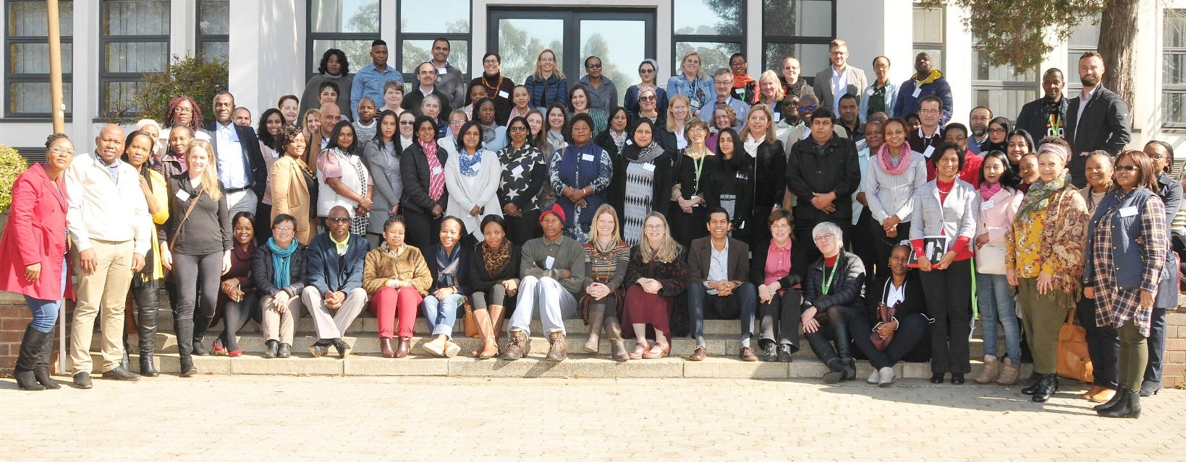
Thank you to all participating patients, laboratory, clinical and administrative staff for submitting case reports and isolates
NICD Centre staff:
CED: Bolele Disenyeng, Dineo Bogoshi, Lesego Thipenyane, Lizzy Madiwani, Mzikazi Dickmolo, Nomsa Tau, Rembuluwani Netshikweta, Sandrama Nadan, Shannon Williams, Tersia Kruger, Tshegofatso Ntshabele, Tumiso Moketla
CHARM: Amanda Shilubane, Boitumelo Kgoale, Boniwe Makwakwa, Ernest Tsotetsi, Gloria Molaba, Gift Sandhleni, Mbali Dube, Mpho Thanjekwayo, Naseema Bulbulia, Nikiwe Power, Rosah Mabokachaba, Rotondwa, Miriam Mwamba, Mudau, Rubeina Badat, Ruth Mogokotleng, Sabelle Jallow, Serisha Naicker, Silondiwe Nzimande, Tsidiso Maphanga
CRDM: Dineo Mogale, Fahima Moosa, Happy Skosana, Kedibone Ndlangisa, Maimuna Carrim, Noluthando Duma, Rivionia Nero, Sibusisiwe Zulu, Thembi Mthembu
CEZPD: Angelina Seko, John Ratabane, Lisa Ming Sun, Ntswaki Seolwanyane, Shareen Boughan, Thandokuhle Tshabalala
DPHSR: Emily Sikanyika, Tsakane Nkuna, Yoliswa Qulu
NICD GERMS-SA Surveillance Review, 16-17 July 2019
GERMS-SA: Loyiso Mnqokoyi, Vanessa Pearce (EC); Bonita van der Westhuisen, George Papsig, Kabelo Finger, Monnya Motlhapi, Thabo Mokoena (FS); Anwar Hoosen, Barry Bhagoobhai, Charl Verwey, David Moore, Dini Mawela, Gary Reubenson, Grace Ntlemo, Jeannette Wadula, Jeremy Nel, Lauren Richards, Lesego Mothibi, Maphoshane Nchabeleng, Masego Moncho, Merika Tsitsi, Moamokgethi Moshe, Mohammed Said, Molebogeng Kolojane, Nazir Ismail, Nicolette du Plessis, Rispah Chomba, Sarah Stacey, Sne Ndzandzaba, Teena Thomas, Theunis Avenant, Trusha Nana, Vindana Chibabhai (GA); Douglas Wilson, Fathima Naby, Halima Dawood, Khine Swe Swe Han, Lisha Sookan, Mbongiseni Dlamini, Nomonde Dlamini, Praksha Ramjathan, Prasha Mahabeer, Prathna Bhola, Romola Naidoo, Sumayya Haffejee, Surendra Sirkar, Venesh Rajkumar (KZN); Ken Hamese, Phetho Mangena, Ruth Lekalakala, Virginia Ntswane (LP); Aretha Mokgoadi, Gugu Mncube, Isaac Mofokeng, Lerato Motjale, Mbongiseni Nkambule, Ndalamo Makatu, Thembi Mbowane ,Thulisile Maphosa (MP); Eugenie Elliott, Pieter Jooste (NC); Ebrahim Variava, Ignatius Khantsi, Omphile Mekgoe (NW); Adrian Brink, Andrew Whitelaw, Angela Dramowski, Anthea Ryan, Arifa Parker, Elizabeth Prentice, Heather Finlayson, James Nuttal, Jantjie Taljaard, Kessendri Reddy, Sipho Dlamini (WC); Ebrahim Hoosien, Inge Zietsman, Terry Marshall, Xoliswa Poswa (AMPATH); Chetna Govind, Juanita Smit, Keshree Pillay, Sharona Seetharam , Victoria Howell (LANCET); Catherine Samuel, Marthinus Senekal, Colleen Bamford (PathCare); Andries Dreyer, Louis Marcus, Warren Lowman (Vermaak and Vennote); Adrian Puren, Anne von Gottberg, Anthony Smith, Azwifarwi Mathunjwa, Bhavani Moodley, Caroline Maluleka, Cecilia Miller, Charlotte Sriruttan-Nel, Cheryl Cohen, Jacqueline Weyer, Jackie Kleynhans, Jenny Rossouw, John Frean, Kate Bishop, Kerrigan McCarthy, Liliwe Shuping, Linda de Gouveia, Linda Erasmus, Lucille Blumberg, Marshagne Smith, Martha Makgoba, Mignon du Plessis, Mimmy Ngomane, Mokupi Manaka, Nelesh Govender, Neo Legare, Nicola Page, Nishi Prabdial-Sing, Nombulelo Hoho, Olga Perovic, Phuti Sekwadi, Rudzani Mashau, Ruth Mpembe, Ruth Mogokotleng, Sabelle Jallow, Sibongile Walaza, Sunnieboy Njikho, Susan Meiring, Susan Nzenze, Tiisetso Lebaka, Tuelo Matotong, Vanessa Quan, Veerle Msimang, Wendy Ngubane (NICD).
Provincial surveillance teams: Badikazi Matiwana, Sandisiwe Joyi (EC); Khasiane Mawasha, Thandeka Kosana (FS); Chulumanco Nkosi, Deborah Makobe, Dikeledi Leshaba, John Mothlasi, Kamohelo Van Eck, Molly Morapeli, Nthabiseng Motati, Ntombizanele Nkomo, Ophtia Kaoho, Patience Ngube, Phindile Ngema, Phumelelo Mavundla, Rachel Nare, Venesa Kok, Vusi Ndlovu, Zodwa Kgaphola (GA); Indran Naidoo, Nelisiwe Buthelezi, Nhlakanipho Malinga, Nkoshinathi Mbhele, Nondumiso Amahle Khoza, Nothando Mthembu, Thobeka Simelane Shandu (KZN); Tebogo Mangena (LP); Elizabeth Motaung, Gift Mnisi, Kgashane Rapaledi, Lesley Ingle, Ndugiselo Muravha, Sam Chongo, Tumelo Thlomelang, Zanele Sewele, Godfrey Ndlovu (MP); Bernard Motsestse, Kholiwe Mgidlana, Koketso Manaka, Sebongile Quariva, Seiphati Matshogo, Tshwanelo Mahloko, Yvette Nero (NW); Babalwa Magawu, Charlene Isaacs, Cheryl Mentor, Kholofelo Lebelo, Lerato Qoza, Msimelelo Madlingozi , Nazila Shalabi, Phathiswa Rangyana, Portia Maphumulo, Priscilla Mouton, Sinesipho Makaluza, Yonela Zokufa, Zama Mfundisi (WC)

Slide 17
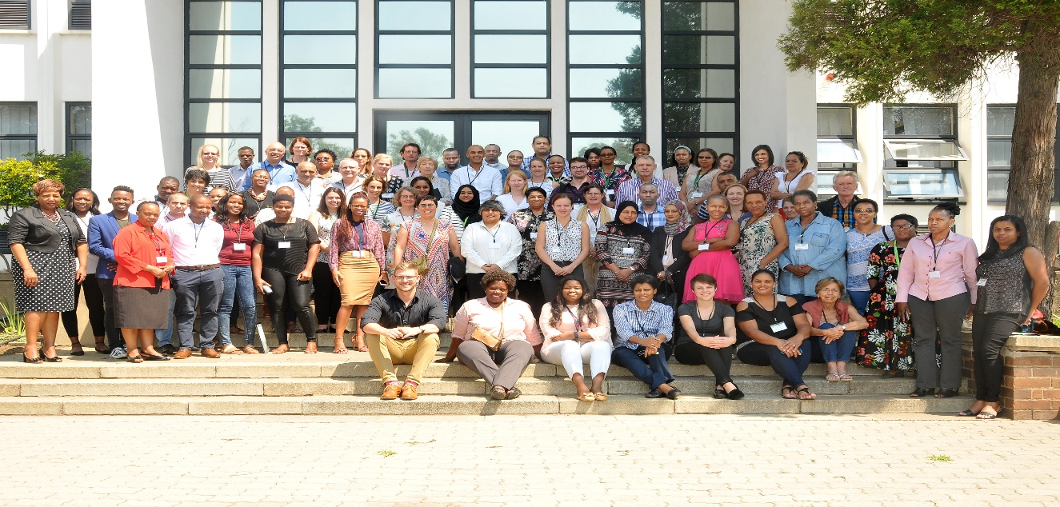
Influenza-like illness and national syndromic surveillance for pneumonia, South Africa, 2022
Surveillance Officers & Research Assistants Babalwa Magawu
Bernard Motsetse
Cecilia Miller
Charlene Isaacs
Cheryl Mentor
Chulumanco Nkosi
Elizabeth Motaung
Gift Mnisi
Godfrey Mabunda
Innocent Kweyama
Kate Bishop
Koketso Manaka
Kholiwe Mgidlana
Lerato Qoza
Lucia Nondyebo Madolo
Milliah Hlathi
Moroesi Mosepele
Myrah Moremi
Ndugiselo Muravha
Nhlakanipho Malinga
Noluthando Gamka
Nombulelo Sithebe
Nomvuyiso Yako
Nonceba Hilda Ngubo
Nondumiso Khoza
Nosisa Simanga
Nothando Mthembu
Patience Ngube
Phindile Ngema
Palesa Seutloali
Phathiswa Ranyana
Phumelelo Mavundla
Priscilla Mouton
Seipati Matshogo
Sunnieboy Njikho
Tuelo Matotong
Tshwanelo Mahloko
Vanesa Kok
Wendy Ngubane
Zanele Sewele
Zukiswa Kibi
Data Entry Team and Administrators
Boitumelo Chuene
Faakhiera Stellenboom
Robert Musetha
Shirley Mhlarhi
Judith Tshabalala,
Thembi Mthembu
Nondumiso Makabate
Mpho Ntoyi
Thelma Maswanganyi
Centre for Respiratory Diseases and Meningitis:
Alexandra Moerdyk, Amelia Buys, Anne von Gottberg, Azwifarwi Mathunjwa, Cardia Fourie, Cayla Reddy, Cheryl Cohen, Daniel Amoako, Emmanuel Phalane, Fahima Moosa, Fiada Mothapo, Hanif Carrim, Jackie Kleynhans, Jinal Bhiman, Jocelyn Moyes, Josie Everatt; Kedibone Ndlangisa, Maimuna Carrim, Mignon du Plessis, Mpilo Mabuza, Mzimasi Neti, Mvuyo Makhasi, Nicola Chiwandire, Nicole Wolter, Noluthando Duma, Linda De Gouveia, Phiwokuhle Ntombela, Retshiditswe Kotane, Sibongile Walaza, Sibusisiwe Zulu, Siyabonga Mazibuko, Stefano Tempia, Theresa Mashaba, Thulisa Mkhencele, Thulisile Nkabinde, Wesley Dlamini
Edendale Hospital: Halima Dawood, Fathima Naby, Sumayya Haffejee
Klerksdorp/Tshepong Hospital Complex: Khumo Bardman, Omphile Mekgoe, Ebrahim Variava
Rahima Moosa Mother and Child and Helen Joseph Hospitals : Ashraf Coovadia, David Spencer, Gary Reubenson , Jeremy Nel, Zodwa Kgapola
Red Cross Hospital/ Mitchell’s Plain District Hospital/ Eastridge Clinic/ Mitchell’s Plain CHC: Heather Zar
Tygerberg Hospital: Arifa Parker
Tembisa Hospital: John Mathabathe
Livingstone Hospital: John Black
Mpumalanga/Matikwana: Neydis Baute, Godfery Sewele
MRC/Wits Rural Public Health and Health Transitions Research Unit (Agincourt): Kathleen Kahn, Rhian Twine , Stephen Tollman
Centre for Disease Control and Prevention (CDC): Aaron Samuels
GERMS-SA: Mokupi Manaka, Susan Meiring, Vanessa Quan, Kate Bishop
All the patients who kindly agreed to participate in the surveillance

Slide 18
















Acknowledgements
Africa PGI
This work was supported in part by a Fogarty International Center Global Infectious Disease research training grant, National Institutes of Health, to the University of Pittsburgh and National Institute for Communicable Diseases (D43TW011255)
https://crdm.nicd.ac.za/projects/sapphgene/

Slide 19
